Slide 1

RentIt – An online car rental platform
Project Supervisor : Dr. Sankari M.
Name of the Student : Rakshith R.
Register Number : 39110832
Department of CSE

Slide 2
Presentation Outline
Course Certificate
Introduction
Objectives
System Architecture / Ideation Map
Module Implementation
Application Snapshots
Results and Discussions
Conclusion & Future work
References
13 April 2022
Department of CSE

Slide 3
Course Certificate

Slide 4
Introduction
The self-drive online car rental car is categorized as one of the most sought-after modes of commute preferred by many online car rental customers.
Self-drive online car rental services provide the customer with full control over the rental vehicle for the stipulated time period.
Many platforms offer hourly, daily, or even monthly online car rental services to their customer.
This service proves extremely useful for tourists looking to procure vehicles in tourist destinations for a limited time period.

Slide 5
Introduction
The car rental industry in India has a very limited share in the transportation sector due to several reasons.
This domain was further severely affected by the outbreak of Covid-19.
The thing is that car reservation systems are heavily dependent on tourism.
Therefore, it comes as no surprise that the travel restrictions harmed this market.

Slide 6
Introduction
Still, the latest industry reports show that the demand for car booking systems remains pretty high.
It is predicted that the car rental market will reach $131 billion by 2026.
The cost-effectiveness of the car rental reservation process and the user experience serves as a key reason for such growth.
The rise of new technologies boosted the market significantly. Their active adoption enables service providers to offer customers better user experience.

Slide 7
Objectives
The Objective of this study is to provide a car rental platform that is reliable as well as sustainable to both the user and the car rental organization.
This project allows the user to produce a web-based system that allow customer to register and reserve car online and for the company to effectively manage their car rental business and to ease customer’s task whenever they need to rent a car.

Slide 8
Objectives
Analyzing data leads to adapt the prevention model of the countries that are doing great in terms of lowering the graph.
Through this project, a step towards helping people to understand the spread and predict the cases in their country is done. This project also gives an insight of how a country is doing in terms of limiting the spread.
There is enough scope for car rental services in India in the future if they understand the Indian shoppers’ psyche and cater to their needs.

Slide 9
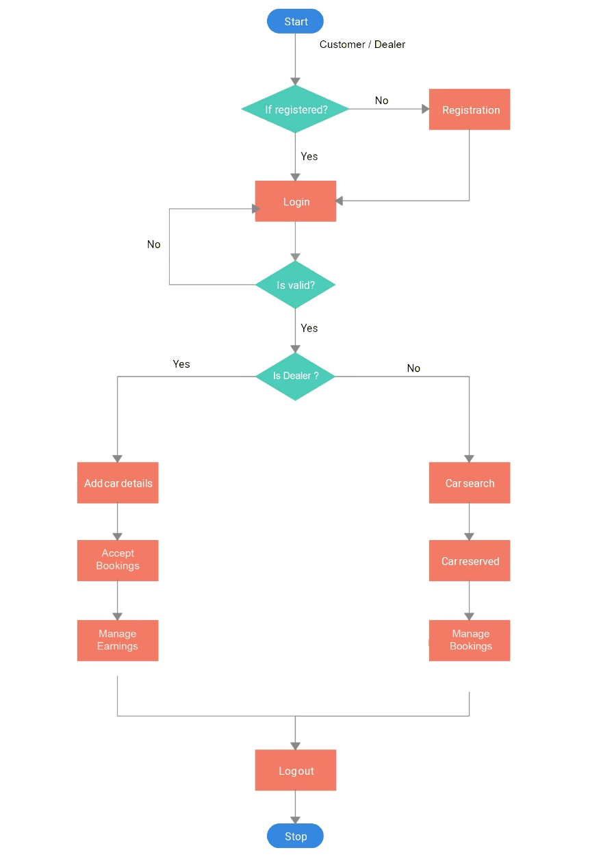
System Architecture / Ideation Map

Slide 10
Modules
System Requirements
Software Requirements
Methodology
Results and Discussion

Slide 11
System Requirements
Processor | Intel Pentium 233Ghz or better performance
Operating System | Window 7 or more
Memory | Minimum 4GB RAM
Screen Resolution | Monitor with screen resolution minimum 1024 x 768
Hard disk Space | Minimum 5GB to include database usage for future

Slide 12
Software Requirements
In this Project we will be using Python, Django and MySQL as the main components for building the project.
Plugins like pytz, mysqlclient, sqlparse, asgiref are also included to make the interface work smoothly and build the backend of the project.
The front end of the platform only consists of HTML and css with some ‘@import’ modules.

Slide 13
Methodology
When the project’s server is accessed through a browser, the browser sends a GET request to the Django module. This request is then passed to the MySQL database from Django.
Django redirects its request to the ‘urls’ section of it. The url section identifies what model should be used in the situation and redirects it further to the ‘views’ section.
‘Views’ section has links to different ‘models’ hence the request is moved onto this section. Finally it is transferred to the template section, where the result is displayed as the GUI output.

Slide 14
Methodology
Most of the data processing happens in the server side, i.e.) Django. Django has 4 main components for it to run.
They are url, view, model, template. The ‘template’ consists of all the front-end codes of the project. ‘Model’ consists of the structure of the project and is used to redirect the processing to the required path.
‘View’ consists of the main code for the project and is the base file. ‘url’ consists of all the sub-directories of the present project and is required to redirect the links.

Slide 15
Methodology

Slide 16
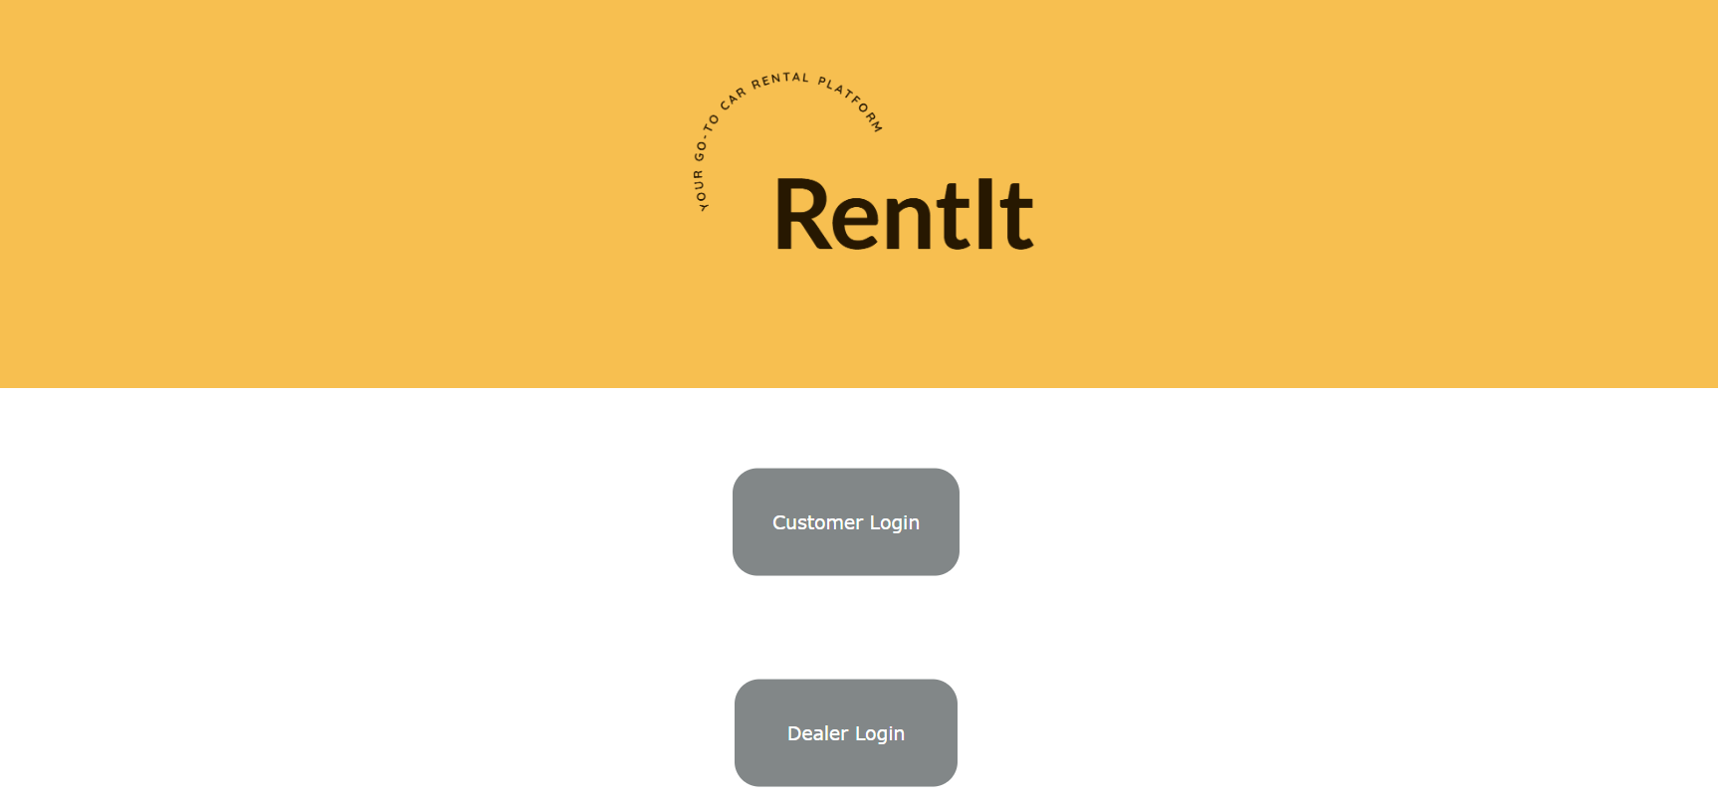
Results and Discussion
This is the landing page / home page of this project prompts the user to select any of the two options provided. The user can login in as a customer by clicking ‘Customer login’ or as a dealer by choosing ‘Dealer login’.

Slide 17
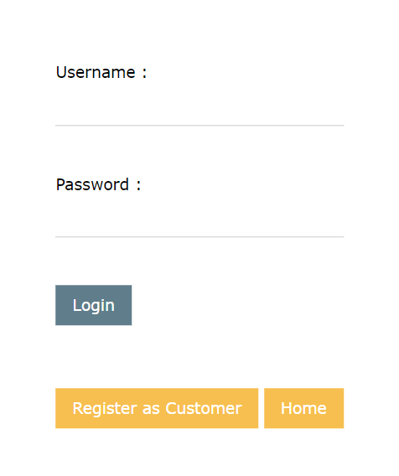
Results and Discussion
When the user clicks any one of the previous options, they will be directed to the login page of that respective portal. This page prompts the user to enter a user name and a password. This also has a registration button and a button to redirect to the landing page of the project.

Slide 18
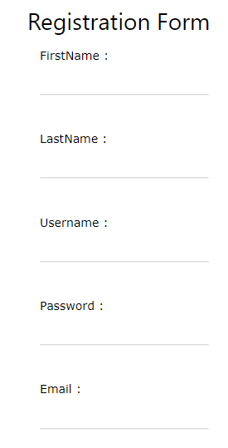
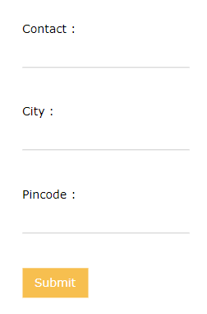
Results and Discussion
The registration page prompts the user to enter multiple details to get registered to the website including Name, username, password, mail, city , contact and pin code. This registration form is common for both customers and dealers.

Slide 19
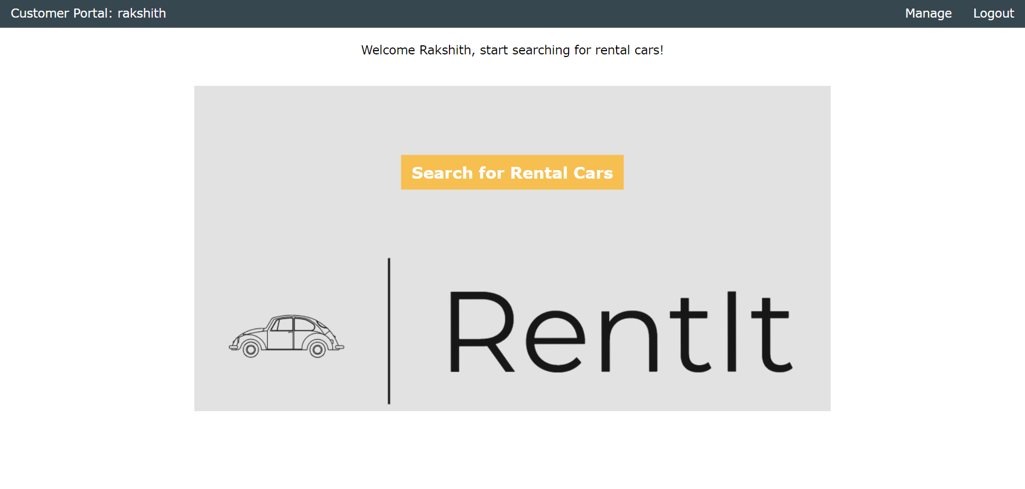
Results and Discussion
After successfully logging in with valid credentials of a customer, the user will be redirected to the home page of the customer portal. This page welcome the user with their first name and has 3 buttons for the user to interact with. Each redirects the user to a new page.

Slide 20
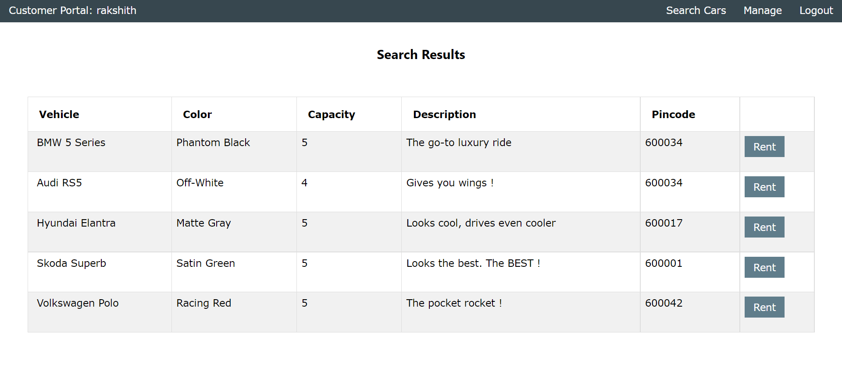
Results and Discussion
After the user enters a city name, the cars that match that city name and is available to rent will be sent from the database. That output will be listed in the search results page. This page allows the user to select the any one car to be rented by prompting the user to click the ‘Rent’ button on the right end of each row.

Slide 21
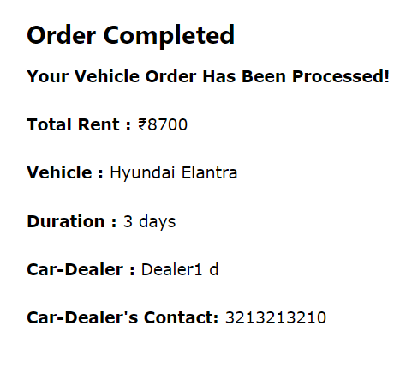
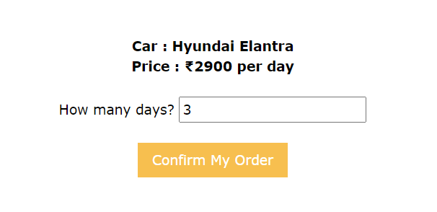
Results and Discussion
After the user selects a car and click on ‘Rent’, the user will be redirected to a confirmation page. This page prompts the user to enter the number of days the car needs to be rented. It also displays the rent per day for the user to be aware of.
When the ‘Confirm My order’ button is clicked, the order is generated and the user is redirected to a order completion page.

Slide 22
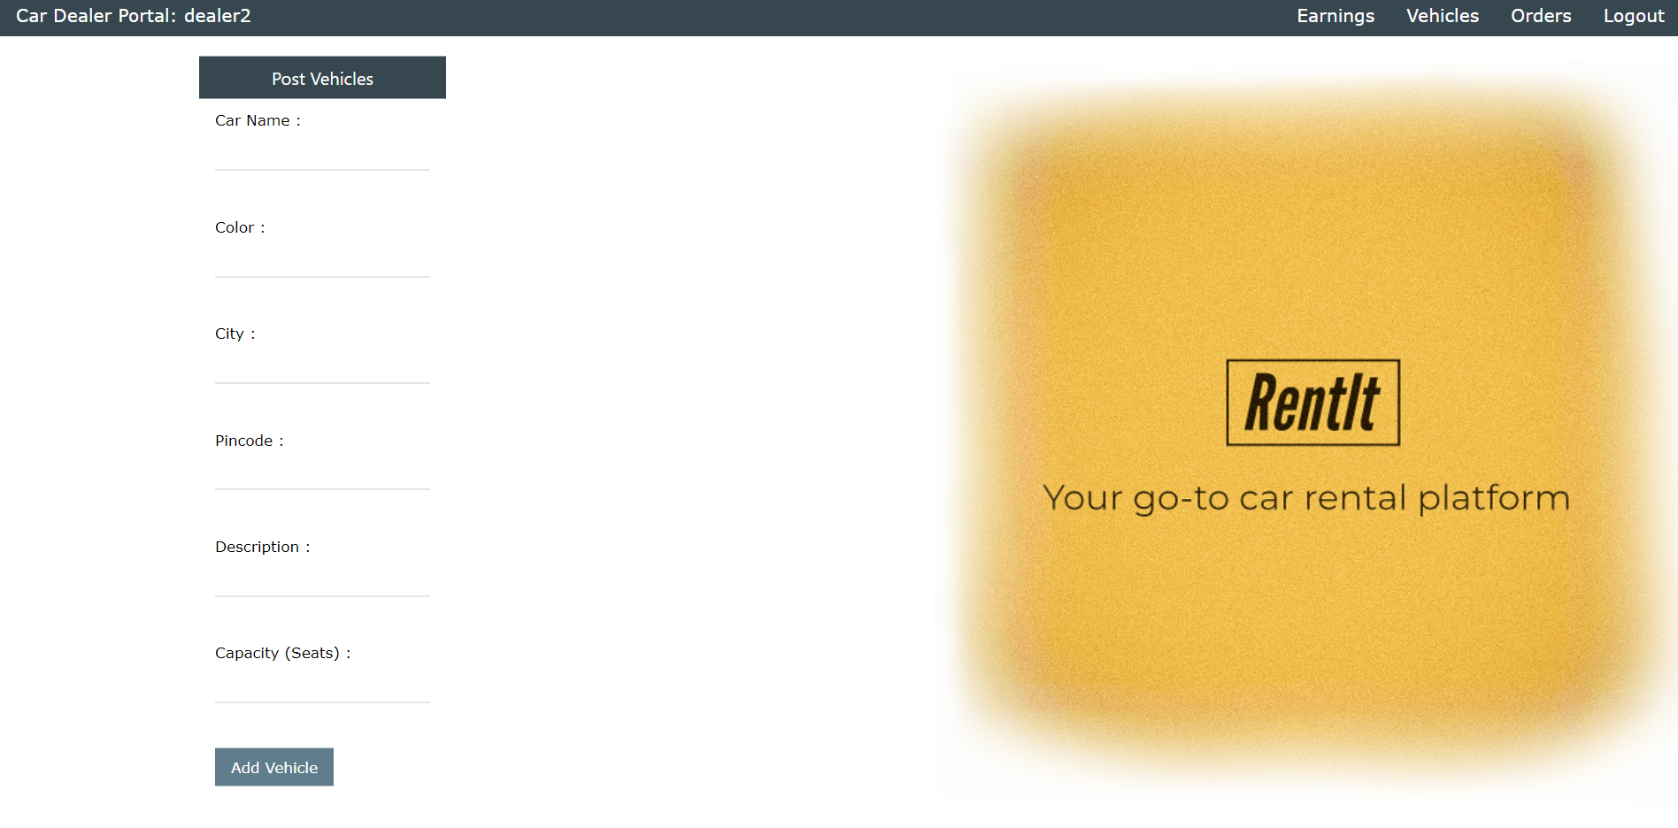
Results and Discussion
After logging in with valid credentials of a dealer, the user will be redirected to the home page of the dealer portal. This page allows the dealer to add a new car to the rental management system. It has 4 buttons in the navigation bar for the user to interact with each leading the user to a new page

Slide 23
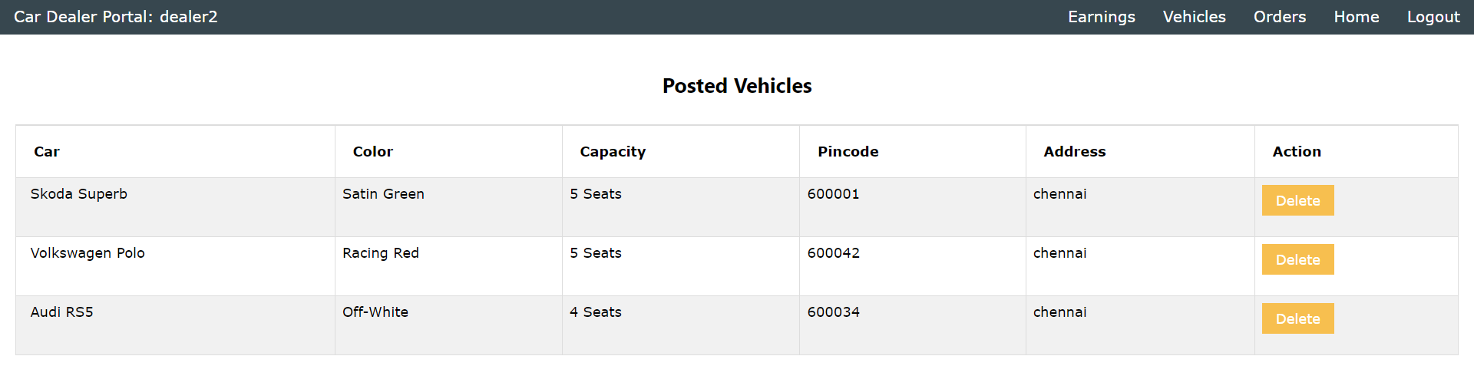
Results and Discussion
When the ‘Vehicle’ button is clicked, the user is redirected to the vehicles page where the list of all vehicles posted by the dealer is displayed. The dealer has the access to remove any car he added by clicking the ‘Delete’ button.

Slide 24
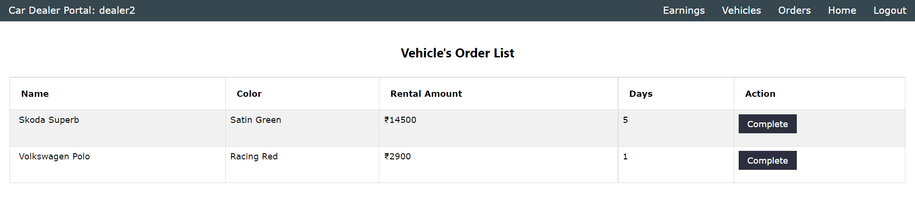
Results and Discussion
If the user clicks the ‘Orders’ button, they will be redirected to the orders page. Here the dealer can take a look of the all the orders they received from the customers. This page displays the number of days car needs to be rented and the total amount of the order. The order is validated only when the dealer clicks on the ‘Complete’ button on the right end of each order.

Slide 25
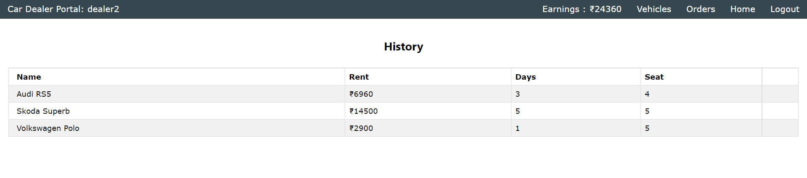
Results and Discussion
The earnings page is displayed when the user clicks the ‘Earnings’ button on the navigation bar. This page lists all the order history that the dealer has received in an ordered manner, with the rent, and number of days. This page also sums up the total earnings of the dealer and displays it in the navbar.

Slide 26
Conclusion
Car rental business has emerged with a new goody compared to the past experience where every activity concerning car rental business is limited to a physical location only.
Even though the physical location has not been totally eradicated, the nature of functions and how these functions are achieved has been reshaped by the power of internet.
These car rental platforms allow customers to reserve cars online, rent car online, and have the car brought to their door step once the customer is a registered member or go to the office to pick the car.

Slide 27
Conclusion
The web-based car rental system has offered an advantage to both customers as well as Car Rental Company to efficiently and effectively manage the business and satisfies customers’ need at the click of a button.
The main scope of this project to develop a user-friendly car rental platform and provide people the access to this huge rental industry with genuine car rental policies and extend the automotive/rental sector is succeeded.

Slide 28
References
https://developer.mozilla.org/en-US/docs/Learn/Server-side/Django/Introduction
https://capablemachine.com/
https://www.w3schools.com/django/index.php
https://stfalcon.com/en/blog/post/car-rent-website-development
https://www.globenewswire.com/news-release/2021/11/25/2340991/28124/en/India-Car-Rental-Market-Report-2021-Market-is-Projected-to-Grow-at-a-CAGR-of-9-83-to-Reach-2-030-Billion-by-2026-from-1-053-Billion-in-2019.html

Slide 29
References
https://www.forbes.com/advisor/travel-rewards/car-rental-prices-are-up-what-are-the-alternatives/
https://www.youtube.com/watch?v=PtQiiknWUcI
https://www.educba.com/django-architecture/

